Slide 1
Lakewood Resource & Referral Center
Presented by:
Jay B. Braun, L.S.W., M.S.W., M.S. Ed.,
Director, LRRC
jbraun@lrrcenter.org
212 Second Street, Suite 204
Lakewood, New Jersey 08701
732-942-9292
Notes:
1

Slide 2
Lrrc welcomes…
ARRA STRENGTHENING COMMUNITIES GROUP

Slide 3
MISSION STATEMENT
Social Services Information And Referral (SSIRD) Division;
To provide the entire community with the most comprehensive, accurate and empathetic social services, information, referral, assistance and advocacy, for governmental entitlement and private sector programs throughout the entire spectrum of the human lifecycle experience. We strive to assess the total situation and needs of individuals and families and do not stop with the initial inquiry of issue or problem.
Notes:
3

Slide 4
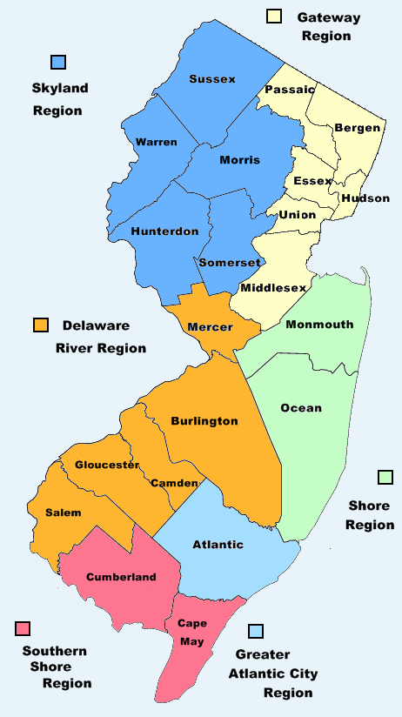
About LRRC
THE LRRC PROVIDES A COMPREHENSIVE RANGE
OF FREE SOCIAL SERVICES FOR
Lakewood Township
Ocean County
New Jersey
Notes:
4
4

Slide 5
Power Point presentations a Marketing Tool
Marketing Inbound
Marketing
Outbound
Marketing
Research
Marketing
Plan

Slide 6
Power Point presentations a Marketing Tool
EXECUTIVE BOARD
UPPER MANAGEMENT & STAFF
INVESTORS
CUSTOMERS
FOR PROFITS

Slide 7
Power Point presentations a Marketing Tool
BOARD
&
STAFF
FUNDERS
&
SUPPORTERS
DONORS & VOLUNTEERS
CLIENTS
NON PROFITS

Slide 8
MARKETING DEFINED
MARKETING
MARKETING
Is used to identify the customer, to satisfy the customer & to keep the costumer.
MARKETING
Process by which companies create customer interest in goods or services .
A wide range of activities involved in making sure that you are continuing to meet the needs of your customers & are getting value in return.
“The activity, set of institutions, and processes for creating, communicating, delivering, and exchanging offerings that have value for customers, clients, partners, and society at large.”
MARKETING

Slide 9
NON PROFIT MARKETING defined
MARKETING
MARKETING
Conducted by organizations and individuals that operate in the public interest or that foster a cause and do not seek financial profits.
MARKETING
Marketing that works to serve the public interest, as opposed to marketing purely for financial gain.
A wide range of activities involved in making sure that you are continuing to meet the needs of your customers & are getting value in return.
MARKETING
“The activity, set of institutions, and processes for creating, communicating, delivering, and exchanging offerings that have value for customers, clients, partners, and society at large.”

Slide 10
MARKETING'S 4 P’S
"Place" is a little less obvious. In addition to determining the best geographic areas to sell in, it also refers to the determination and management of the best "channels" for reaching those markets -- direct sales, distributors, resellers, etc.
All business activities focused on developing, expanding and facilitating the profitable introduction and promotion of a company's products and/or services. Traditionally, this is taken to include the "4 P’s" -- Product, Price, Promotion and Place.
"Product" refers to discovering market requirements and ensuring that those requirements are reflected in the products and/or services offered by the company.
"Price" is obvious -- determining and setting the most appropriate prices for the products/services.
"Promotion" refers to all activities involved in making potential customers aware of the company, its products and services and their benefits -- and encouraging them to buy.

Slide 11
MARKETING……
Activities
Set of
Institutions
Process
Creating
Communicating
Delivering
Exchanges of offering with value
Customers etc. & Society
Observe
Orient
Decide
Act
Strategy

Slide 12
Business vs. Non Profit Goals
Business
Non Profit
Executive Board
Upper Management
Customers
Investors
Board & Staff
Clients
Donors
Funders & Supporters
Profits
Mission

Slide 13
MARKETING QUESTIONS
? #1
Are their real differences between business marketing & non-profit marketing or are just the activities different?
? #2
Should non–profits also develop internet marketing strategies?
? #3
? #4
Why is important to for non profits to also focus marketing on supporters, donors & funders?
How can Power Point Presentations enhance my marketing strategy?

Slide 14
Inbound marketing demographics
Identify specific groups as potential customers
How to meet the needs of each group (target market)
How each group (target market) may choose to access the product / services
How much the customers are willing to pay for the product / services.

Slide 15
Inbound marketing demographics ….
Who are our competitors?
How to design & describe the product so that customers will purchase from us & not the competitors
How the product / service should be identified, its personality, & how to name / brand it.

Slide 16
outbound marketing demographics
Advertising & promotions focused on Product / Services.
Sales / Services
Public & media relations
Customer service
Customer satisfaction

Slide 17
Primary Marketing research
Individual Interviews
Focus Groups
Primary Market Research
Research Surveys

Slide 18
Secondary Marketing Research
Reports & Studies
Local News & Mag’s
Library & Gov’t Agencies
On Line Sites & Trade Assoc.

Slide 19
Marketing plan outline
Company Analysis | SWOT Analysis | Customer Analysis | Competitor Analysis | PEST Analysis | Market Segmentation
Executive Summary | Strengths | Number | Market Position | Political Environment | Desired Products / Services
Research Sales/Services | Weaknesses | Type | Strengths | Economic Environment | Price Sensitivity
Goals | Opportunities | Value Drivers | Weaknesses | Social Environment | % of Sales
Focus | Threats | Decision Process | Market Share | Technological Environment | Use of Product / Svcs
Culture | Expansion Capabilities | Concentration Customer base | Location | *Cultural Environment | How to reach them
Market Share | *Staffing | Census Info | *Expansion Capabilities | *Location Environment | Census Info

Slide 20
MARKETING QUESTIONS
? #1
Are their real differences between business marketing & non-profit marketing or are just the activities different?
? #2
Should non–profits also develop internet marketing strategies?
? #3
? #4
Why is important to for non profits to also focus marketing on supporters, donors & funders?
How can Power Point Presentations enhance my marketing strategy?

Slide 21
MARKETING answers
A #1
Some argue that conceptually they are the same and the only differences are in the activities. Others say they are different, due to the goals. The key is effective marketing activities.
A #2
Absolutely, minimally, you should have a well conceived & constructed website. With the future goal of social website integration.
A #3
A #4
Supporters may facilitate access to future funding, or become volunteers or donors. Funders may increase current funding & /or be favorable for future funding opportunities.
Power Point Presentations can be very powerful & effective marketing tools.

Slide 22
Power points, a Marketing tool
Company Story
Company Cause
Data & Stats
Past Achievements
Impresses Funders

Slide 23
Power points a Marketing tool
Flexibility
Creativity
Target all Levels
May be Easily Modified
Convertible Poster Presentation
Integrate Video
Posted On Line
Make Ideas & Concepts Easily Understandable
Multi-Sensory Powerful

Slide 24
QUESTIONS & ANSWERS

Slide 25
credits
All Business, a D&B Company
Free Market Management Library
John Moss, Marketing Blog
Marcommwise.com
Quick MBA
The American Marketing Association
Wikipedia

Slide 26
Thank You!

